Slide 1
Diagnostic Medicare Center Management System
Team Members:
Anisha Sebastian (538731)
Bertram Russell (538735)
Deepali Jain (536291)
Nitin Paul (536350)
Sahil Sood (536227)

Slide 2
Client Requirements
The client would like to develop an independent application Diagnostic Medicare center Management System (DMS) website which is used for:
To create an account for the new customer
To view the Medicare services.
Apply for any health checkup
To find an medical Insurance agent and services
To view the medical report online.

Slide 3
Current Scenario
Customer data is stored manually in hard-copy format
Applications need to be filled and submitted for applying for health checkups and obtaining medical reports.
Inquiry needs to be made at the reception for information on the available medicare services.

Slide 4
Impact of the system
Automate existing manual processes
Digital records of customer information is maintained
More efficient
Cost effective

Slide 5
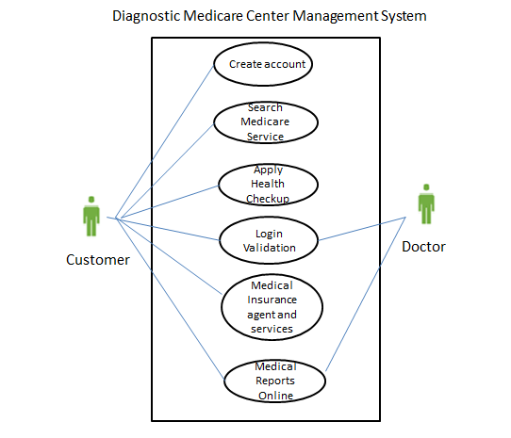
Use Case

Slide 6
MODULES
Home: Display welcome message, contact details, information about the medicare center, registration link.
View Medicare Service: View the required medicare service to check for availability.
Apply Health Checkup: View and apply for the available health checkup plans by filling out the nomination form.
Medicare insurance agents and services: Search for medical agents in customers city.
Medical Reports Online: Customers can view their medical reports online.

Slide 7
System Environment
The proposed technology stack for the project
Java/J2EE – Servlet, JSP (Back-End); JavaScript (Front-End)
Oracle database
Apache Tomcat Server

Slide 8
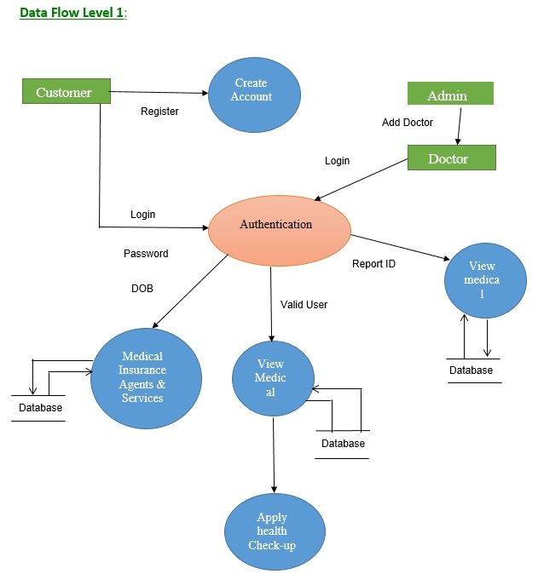
Data Flow Diagrams

Slide 9
THANK YOU

